Slide 1
EE746 Neuromorphic Engineering
Udayan Ganguly
udayan@ee.iitb.ac.in
Aug 2, 2022 (part 1.12)
Notes:
Welcome to EE746!
The course is taught by Udayan Ganguly.

Slide 2
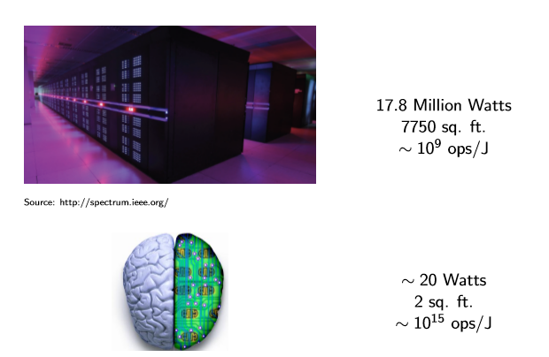
Computation – A comparison
Think: How do we “verify” the energy, area and energy efficiency for computer?
Pair: How do we do the same for the brain?
Notes:
The Watson is the pinnacle of human-made computing; How does it compare with nature?
Lets us use three metrics
1. Initial Cost ➔ one time investment (not considered)
2. Recurring Cost ➔ space and energy
3. Return on investment ➔ computing operations / unit of energy
<Discussion Exercise – Think- Pair- Share>
Challenge: For a computer, this is easy to estimate. For power and space, find room size and use a power meter respectively. For Efficiency, count the number of operations (standard terms). But how does one do it for nature?
Since the equivalence to biology is not obvious at first shot, or cannot be measured directly, we need to use Fermi’s method of estimation – (Fermi Problem- https://en.wikipedia.org/wiki/Fermi_problem)
Area: The brain is a sheet that is crumpled to fit the skull. The crumpling is a specific and enables connections between neighboring folds (https://en.wikipedia.org/wiki/Human_brain). If we spread it, we can measure it.
Power:
We are consuming food (in kCal or J). This is the upper bound of energy that the brain can use; We can choose a fraction (say by volume as a first guess) to estimate energy;
We can measure heat loss (all energy must be lost as heat) ➔ not a good assumption
We can measure the inflow of chemicals associated with energy use (e.g. extent of ATP in blood or oxygen); Again, this will provide an upper bound (but better than #1);
Energy per operation: This has two questions
What is an operation in a brain that that equivalent to a computer?
What is the energy consumed by the brain for specifically that operation?
Here are a few approaches to estimate the first one
Equate spikes to the bits; measure number of spikes; (this approach looks at observing the internal states of the brain)
Find a task (like speech recognition) which a computer can do; assume that the brain does an equivalent number of operations (this approach looks at the output of two system and assumes that the internal states must be equivalent or close)
Others?
**************
Exercise
**************
Criticize the estimations above; based on these weaknesses, try to improve them. (This is a systematic approach to improving your estimates)
The energy for this operation specifically is difficult. But then what is easy ☺ ; Please write down the possibilities here; Check out my guesses in the next slide

Slide 3
How do we measure?
Power
Area
Energy Efficiency
Notes:
Can you invent 5 Fermi Problems and make a strategy to solve 2 of them?

Slide 4
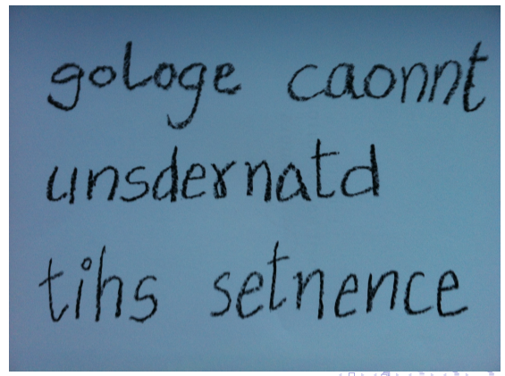
Si vs. C based computation
Notes:
Can you read this sentence? Yes- I think so!
**********************************
<Answer to previous slide>
Use spikes and find energy from O2 or ATP and then do a simple division;
A specific task with a computer equivalent operations estimates the number of ops; energy is measured as compared to a resting state to arrive at net energy for the operation
Both these are estimates; one may compare these to see how different they are!
**********************************

Slide 5

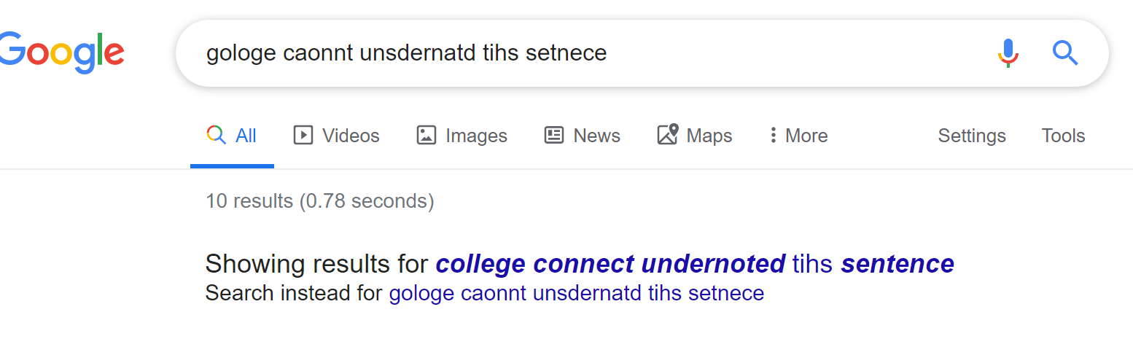
Artificial Intelligence progress
2013
2020
Notes:
In 2013, Google’s AI was not very good; it could not understand this sentence at all
In 2020; Google could understand the sentence but did not recognize its own name ☺ This is ironical! Did google understand the irony?! ☺☺ This is despite all the computing power of server farms.
This is a still a function difference. Efficiency (Energy, Space) is a further advantage of biology.

Slide 6

Artificial Intelligence progress
2022

Slide 7
Outline
How we compute?
Neuromorphic Engineering – Opportunities
Why Neuromorphic engineering?
Notes:
In this lecture, we will introduce 3 aspects.
How do we compute?
This means (i) what are biological elements responsible for computing (ii) how do they form a network (iii) how do they perform computation i.e. for an input, provide an output to mock-up a specific function e.g. classification (input signal is associated with a class), navigation (given an environment, decide an action e.g. direction or speed).
How did we learn such computation?
This is essentially neuroscience (i.e. biology) and its model (computational neuroscience) and algorithms (computer science)
2. Neuromorphic Engineering – Opportunities
The algorithm can be implemented in a standard computer with a or von Neumann architecture. However, such a computer is structurally significantly different from the brain. e.g.
A computer has separate logic and memory leading to the “interconnect bottle neck”; Here, ferrying data between memory and logic units takes the most energy and time.
In comparison, the brain does not have a separate – logic and memory blocks are not separately located. If so, we could remove a section of the brain and replace it with another persons memory to do a replacement. But unlike other organs – this is not done.
Second, the von Neumann computer works on Boolean logic while the brain works on spikes. So, the emulation of spikes based system dynamics with Boolean logic is not a natural ”fit” and requires severe adaptation that is bound to be clunky and inefficient. There are may other differences.
It also turns out that the brain has 100 billion neurons but electronic simulations are crude (http://www.kurzweilai.net/ibm-simulates-530-billon-neurons-100-trillion-synapses-on-worlds-fastest-supercomputer) i.e. digital (not analog) and clocked with no real-time learning.. And extremely inefficient in terms of energy and space.
So the question is… can we make an electronic system that computes more like biology i.e. individual elements like neurons are mapped to circuit elements and architecture is also similarly mapped (no separate logic vs memory blocks but mixed blocks). This imitation could enable us to learn important vs. non-critical structures of biology. Thus, compared to the state-of-the-art – there are significant opportunities (a) to enable efficiency and (ii) to understand biology
3. Why neuromorphic engineering?
This has two aspects
New applications and better efficiency can be enabled
Nanoscale engineering is a new tool to create these architectures. But a holistic approach is needed to enable system engineering: algorithm ⬄ hardware architecture ⬄ device
This is a new inter-disciplinary frontier and requires a new class of engineers.
This is somewhat like when Boolean logic was first created but its hardware/architecture and device required a holistic engineering approach. One difference is that Boole created the logic based on mathematics that had clear structure. For biological neural networks, this biological proof exists for us to observe but even the translation to mathematics and algorithms is necessary. This makes the topic so fascinating as you can see the power of the brain (something we can achieve if we get it right) but the question is hugely challenging.
Of course there is a fundamental paradox to fight on the way. Can a brain understand itself? https://www.edge.org/response-detail/10673
But we don’t have to not worry about that for now.

Slide 8
Outline
How we compute?
Neuromorphic Engineering – Opportunities
Why Neuromorphic engineering?
Notes:
A discussion occurred in class. Why neuromorphic engineering? Many reasons were presented typically in two classes.
Making smaller, faster, better computers
integration with sensors
More energy efficient
Making new functions
Understanding morality and emotions
Developing creativity
Understanding neurological disease and treatment
Computer codes that learns and can generate codes (replacing the coder)
Let us start with “How we compute?” next

Slide 9
Course Content
Goal:
Develop models for each element of SNN – neuron, synapse etc.
Replication algorithms for recognition and learning
Need to be able to code in MATLAB
Course Content
3 Home-works
4 Exams
1 Project to implement learning & recognition tasks
Handwriting
Video
Audio
Navigation

Slide 10

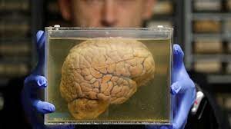
10 Papers by BTP, DDP, MTP students
R. Patel, V. Saraswat, U. Ganguly, “Liquid State Machine on Loihi: Memory Metric for Performance Prediction” ICANN 2022
A. Kishore, V. Saraswat, U. Ganguly, “Simplified Klinokinesis using Spiking Neural Networks for Resource-Constrained Navigation on the Neuromorphic Processor Loihi” IJCNN 2021
J. Chaudhary, V. Saraswat, U. Ganguly, “Algorithm For 3D-Chemotaxis Using Spiking Neural Network” ICANN 2021
S. Landge, V. Saraswat, S. F. Singh and U. Ganguly “n-Oscillator Neural Network based Efficient Cost Function for n-city Traveling Salesman Problem” IJCNN 2020
V. Bhatt, S. Shrivastava, T. Chavan and U. Ganguly, “Software-Level Accuracy Using Stochastic Computing With Charge-Trap-Flash Based Weight Matrix” IJCNN 2020
S. Shukla, R. Rathak, V. Saraswat, U. Ganguly, “Adaptive Chemotaxis for improved Contour Tracking using Spiking Neural Networks” ICANN 2020 link
Ajinkya Gorad, Vivek Saraswat, U. Ganguly, “Predicting Performance using Approximate State Space Model for Liquid State Machines” IJCNN 2019 link
V. Bhat, U. Ganguly “Sparsity Enables Data and Energy Efficient Spiking Convolutional Neural Networks” 27th International Conference on Artificial Neural Networks (ICANN) 2018 link
S. Shukla, S. Dutta, U. Ganguly “Design of Spiking Rate Coded Logic Gates for C. elegans Inspired Contour Tracking” 27th International Conference on Artificial Neural Networks (ICANN) 2018 link
Aditya Shukla, Sidharth Prasad, Sandip Lashkare and Udayan Ganguly “A case for multiple and parallel RRAMs as synaptic model for training SNNs” International Joint Conference on Neural Networks (IJCNN) 2018 link
A. Shukla, V. Kumar, U. Ganguly “A Software-equivalent SNN Hardware using RRAM-array for Asynchronous Real-time Learning” International Joint Conference on Neural Networks (IJCNN) 2017 link
The Project and HWs are key for exploring and transitioning to SNN research!
Discussion are Key to refine concepts!
Notes:
Read about the “intelligent” life of a worm with just 100 neurons.
https://en.wikipedia.org/wiki/Caenorhabditis_elegans

Slide 11
Our goal:
Device
Algorithm
Biological Inspiration
Circuit
System
Why play at different levels?
Why not?

Slide 12

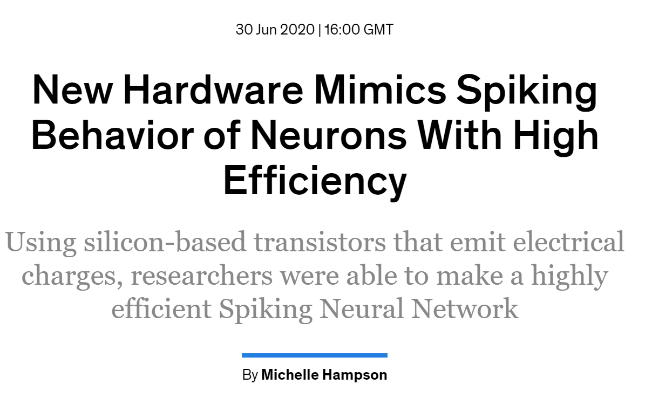
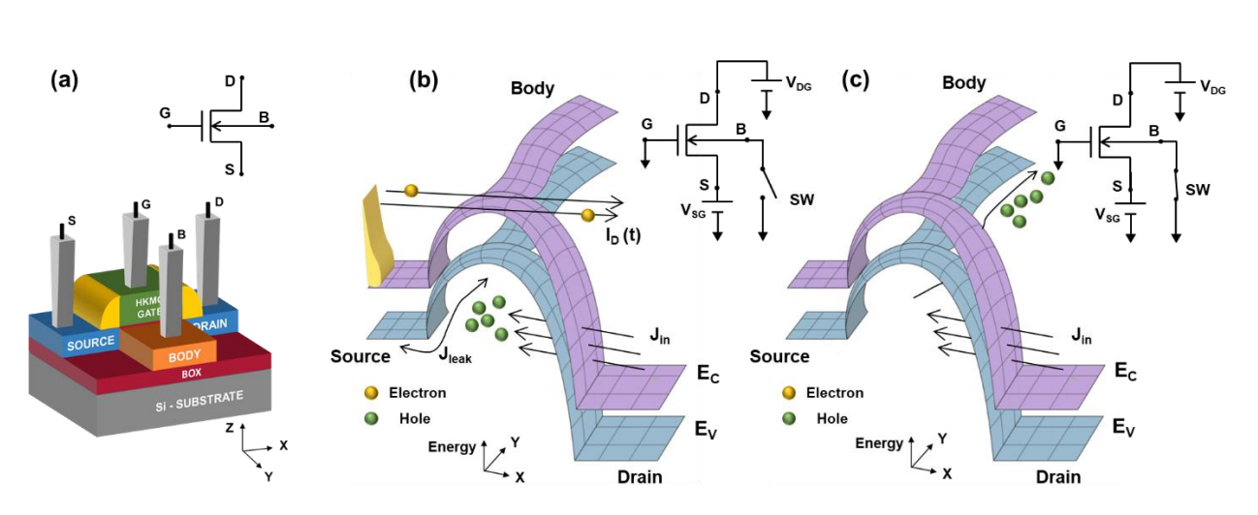
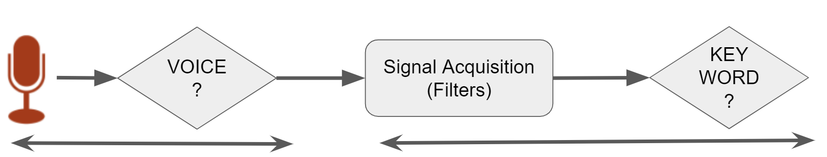
Tech Differentiator: Quantum Tunneling in Silicon enables Efficiency
A group of researchers at the Indian Institute of Technology Bombay designed the new SNN hardware. The design includes silicon-based electrical switches, called Metal-Oxide Semiconductor Field-Effect Transistors (MOSFETs), which are built on an insulating substrate.

Slide 13
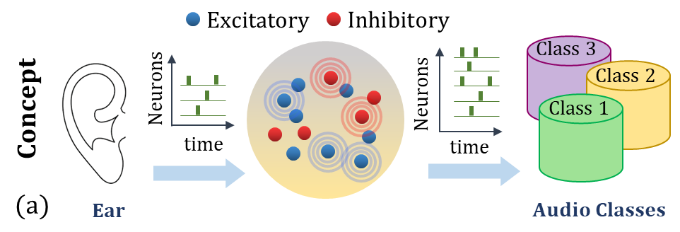
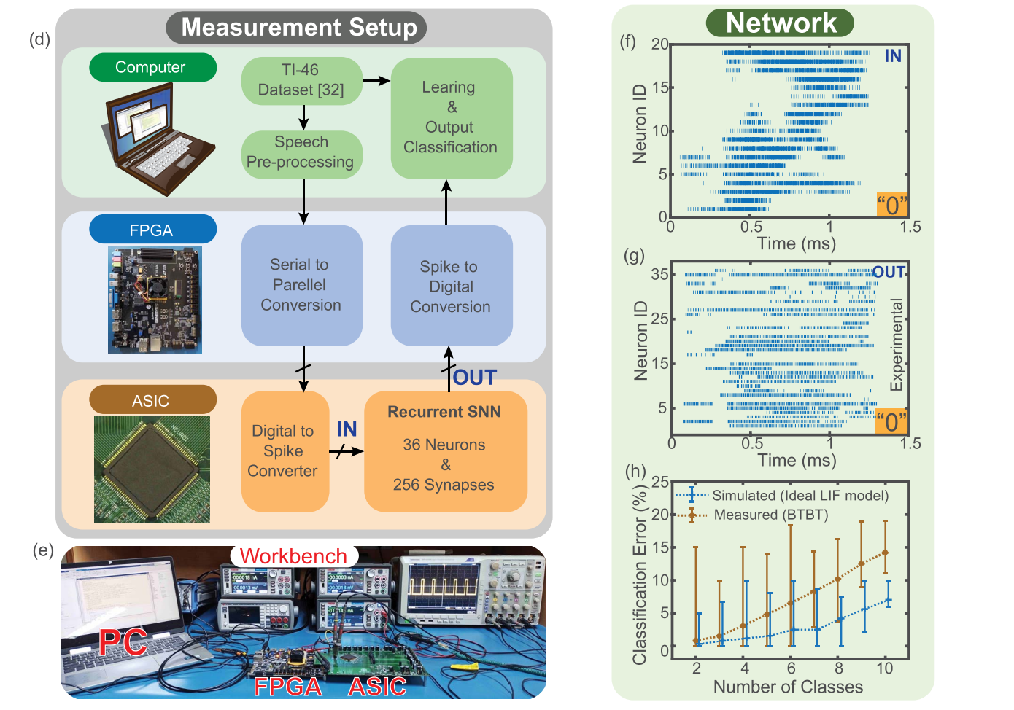
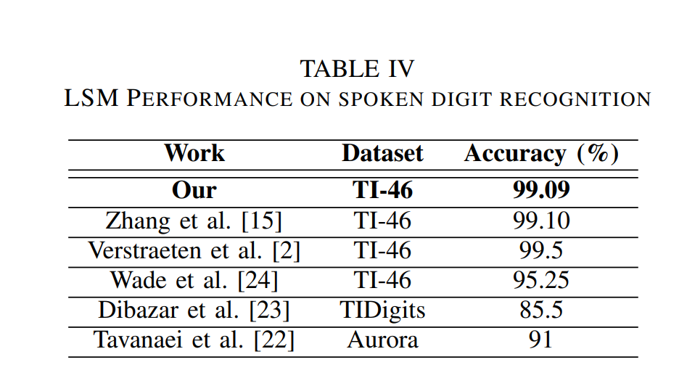

Algo Differentiator: Human Ear Inspired Spoken Word Recognition
$$Auditory Cortex$$
Algorithm performance in high;
Hardware performance tracks algorithm closely

Slide 14
Benchmarking
Authors | Neuron Model | Input Type | Circuit Type | Platform | Tech. Node | Linear | Freq. | Area µm² | Static Power | Energy /Spike | Hardware Implementation | Special Features
(Chavan et al., 2019) | LIF | Voltage | Mixed Mode | SOI CMOS | 32nm | No | 150kHz | 0.8 | - | 3.22fJ | Integrator | -
(Tuma et al., 2016) | IF | Voltage | Mixed Mode | PC + CMOS | 14nm | Yes | 10Hz- 10MHz | 0.5-1 | - | 5pJ | Integrator | -
(Lee et al., 2018) | IF | Current | Mixed Mode | SOI CMOS | - | - | ~70kHz | ~ 12x10³ | - | 360pJ | Neuron | AO
(Basu and Hasler, 2010) | Saddle | Current | Analog | CMOS | 0.35µm | Yes | 100 | 2740 | 1.5nW* | 17.4pJ | Neuron | SFA
(Sourikopoulos et al., 2017) | ML-based | Current | Mixed Mode | CMOS | 65nm | No | 25kHz | 35 | 30pW | 4fJ | Neuron | -
(Qiao and Indiveri, 2016) | IF | Current | Analog | SOI CMOS | 28nm | - | 100Hz | 50 | 9.8nW | 50pJ | Neuromorphic processor | SFA, RPM
(Zhang and Wijekoon, 2019) | LIF | Current | Analog | CMOS | 0.35um | - | 1MHz | 2800 | 1.3nW* | 8pJ-9pJ | Cortical Neuron Chip | SFA, FS, IB, CH
(Cruz-Albrecht et al., 2013) | LIF | Voltage | Mixed Mode | CMOS | 90nm | No | 100Hz | 442 | 16pW* | 400fJ | Scalable neural chip | -
This Work | LIF | Voltage | Mixed Mode | SOI CMOS | 45nm | Yes | 100kHz | 40 | 2.7pW | 8.2fJ | LSM Reservoir | -
Our results are best in the world for complete combination: energy, area, standby power!

Slide 15

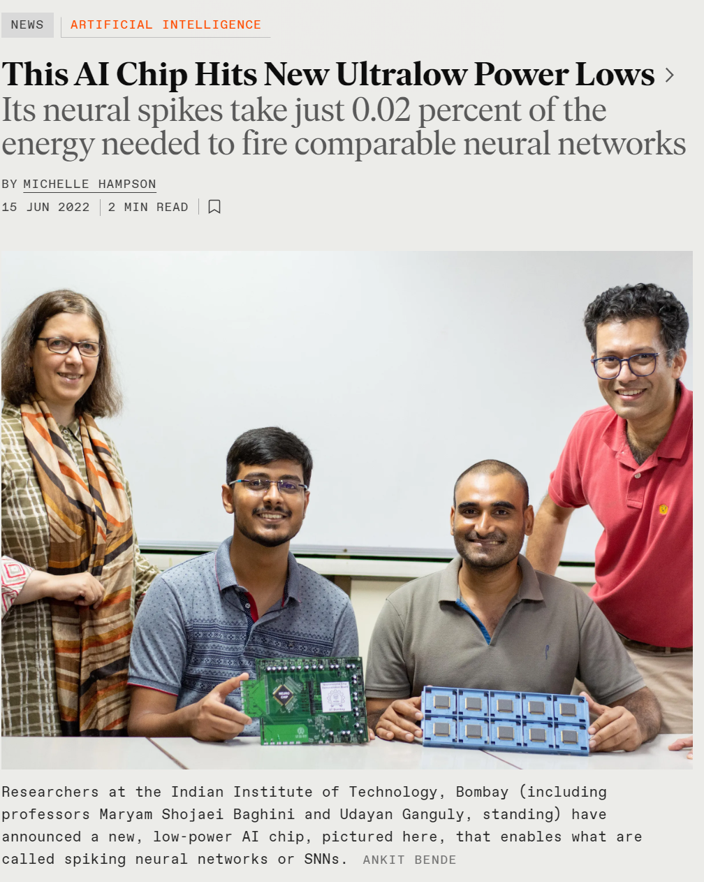

The World’s Tunneling Enabled First Spiking Neural Network Chip on 45nm SOI Technology from India
Dr. Ted Letavic, CTO of Compute and
Wired Infrastructure Business Unit
GlobalFoundries
“This is pioneering work that showcases the advantages of mature SOI technology to demonstrate a new neural compute paradigm based on quantum tunneling."
Prof. Ajay Sood,
Principal Scientific Advisor (PSA)
to the Government of India remarked
“Demonstrating silicon-proven ideas based
on an untapped quantum phenomenon in silicon
to build efficient brain-like computing is promising on the global scale. The confluence of the national semiconductors priority as well as the emergence of AI and brain-scale computing hardware as the R&D focus at the global level makes the demonstration very timely and compelling.”

Slide 16
Can IIT Bombay build a brainscale SNN chip?

Slide 17

How do we learn? about learning?
SNNs or ourselves?
Think: To understand an Idea by yourself
Pair: To collaboratively learn with your buddies from a nebulous stage
How can by buddies get it right? I am surely better, ain’t I ?
OR
Can I further refine my buddies ideas and create a greater idea?
Share: To present a matured thesis and understand its strength/weaknesses
After all, ______ not _______ must win! (in a civilized world … not wild west!)

